Slide 1

Robotic Process Automation
Teoh Teik Toe
ITOM/NBS
ttteoh@ntu.edu.sg
97905202

Slide 2
Recording: https://1drv.ms/v/s!Aik2a4x7tvLyi6xHOOZ2Mrv7Sa1LBA?e=fLNNyf

Slide 3

Objective
To know about Robotic Process Automation and able to use UiPath to automate processes
To create a simple automated process using UiPath
To develop RPA programming skill

Slide 4
Agenda
Intro to RPA
UiPath
Exercise
Discussion
Review
Examples of RPA:https://mindmajix.com/30-rpa-examples

Slide 5
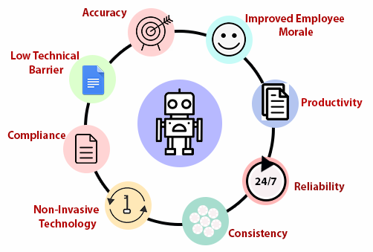
Why RPA

Slide 6
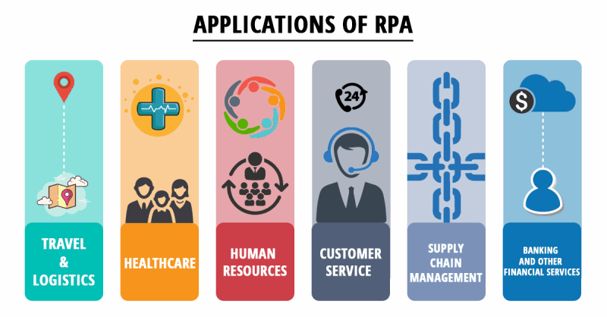

Slide 7


Slide 8
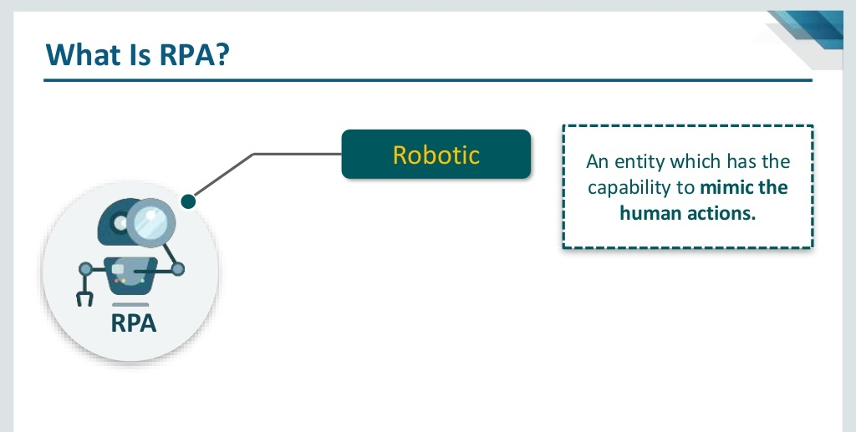

Slide 9
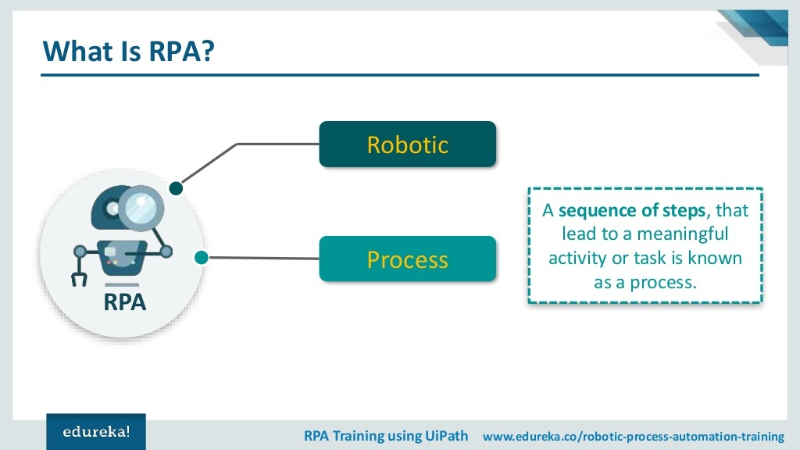

Slide 10
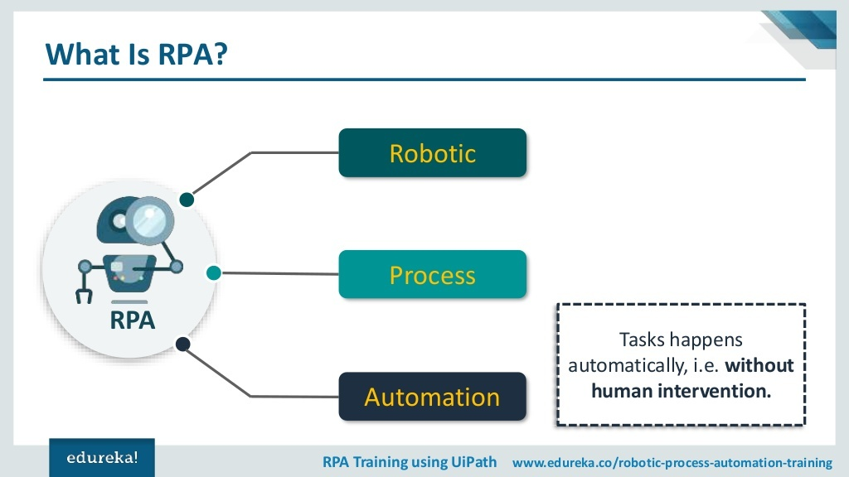

Slide 11
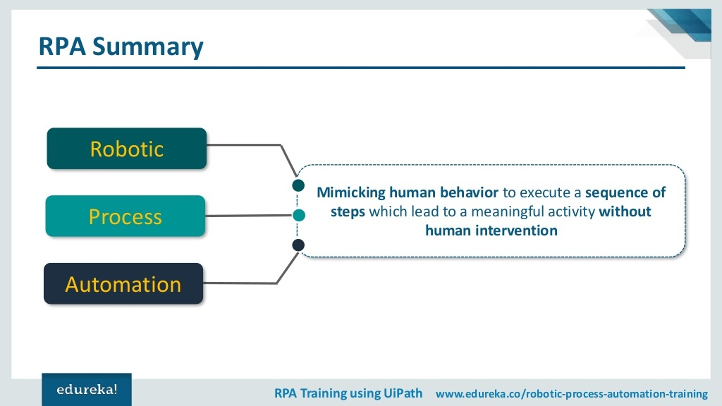

Slide 12

Used Case in RPA
https://cdn.featuredcustomers.com/CustomerCaseStudy.document/Department_for_Work_and_Pensions_4VRL0kX.pdf

Slide 13
Processes can be automated with RPA
Word
Email
Excel
Browser
Other application such as Calculator

Slide 14
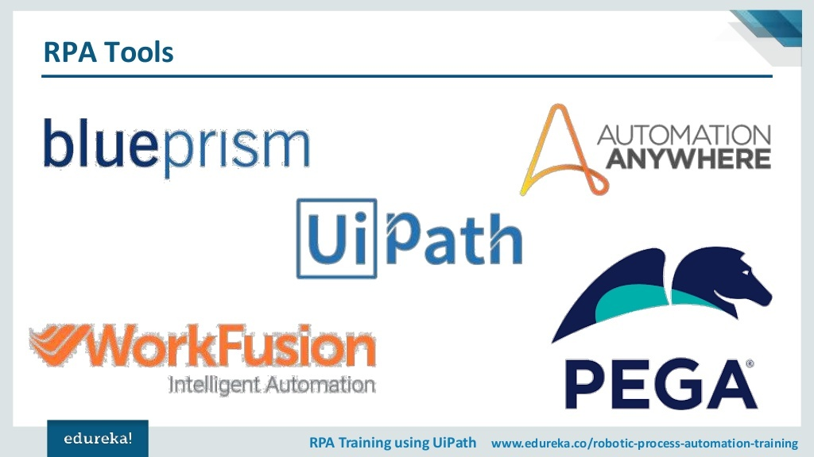

Slide 15
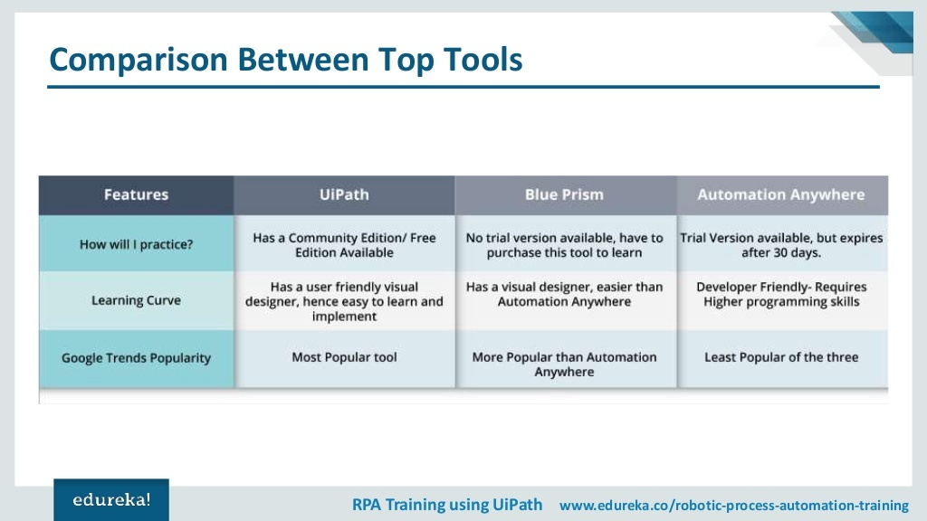

Slide 16
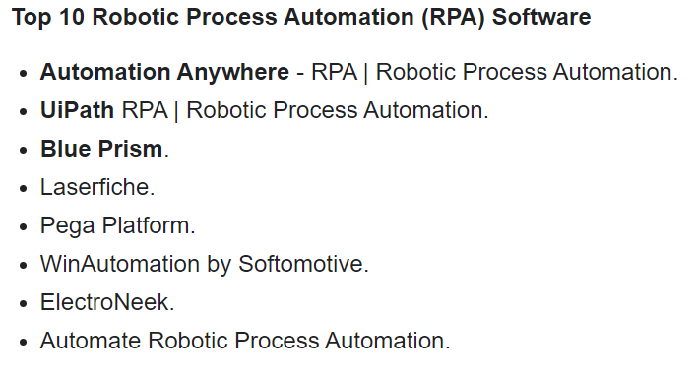
Why we choose UiPATH (Rank #2 by G2)
https://www.g2.com/categories/robotic-process-automation-rpa

Slide 17
RPA Studio Web

Slide 18
Simple Task
Read from google sheet and write to google form
REMEMBER TO NAME THE SHEET and FORM differently to avoid tab name CONFUSION

Slide 19
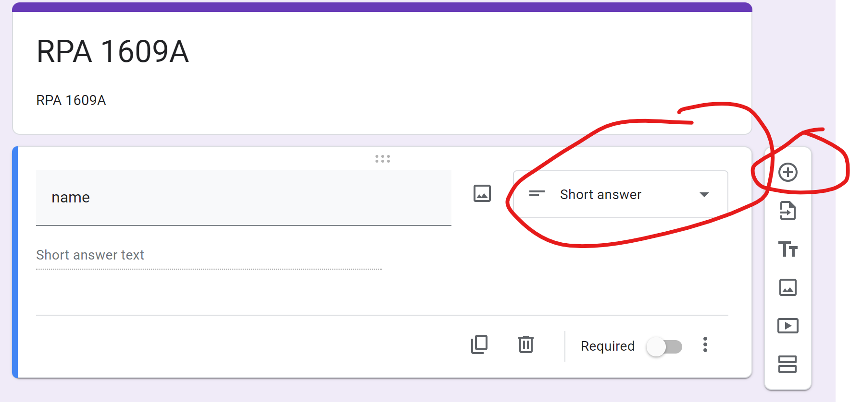
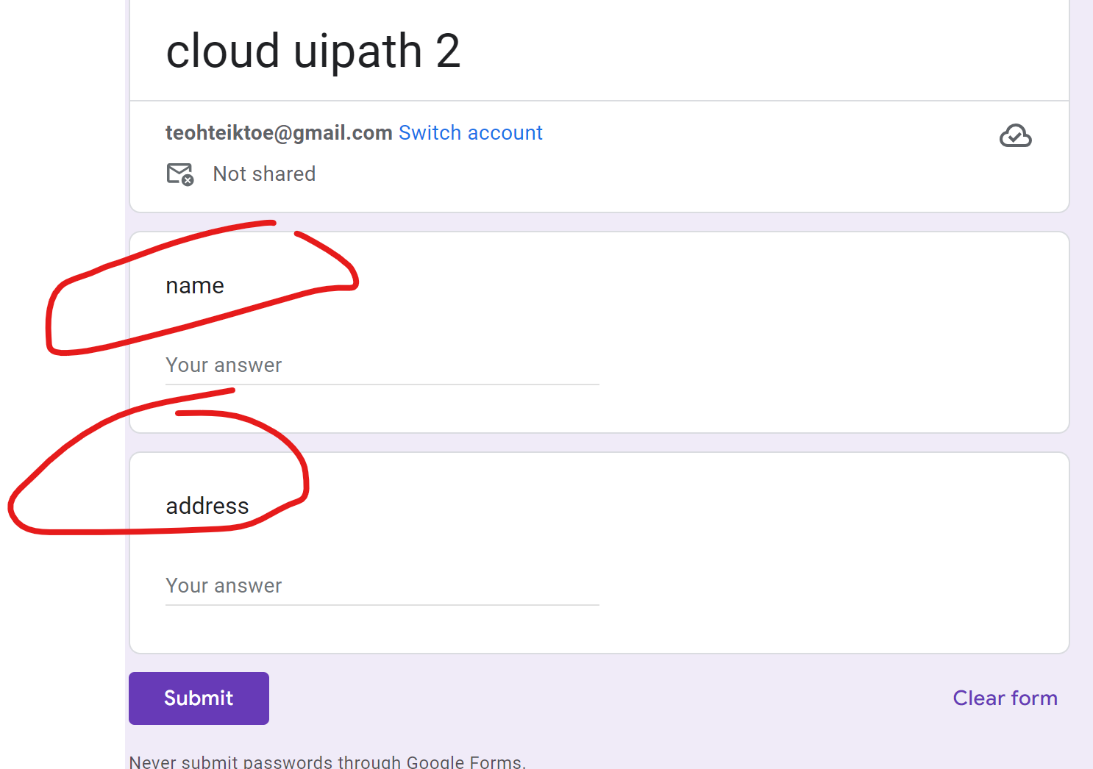
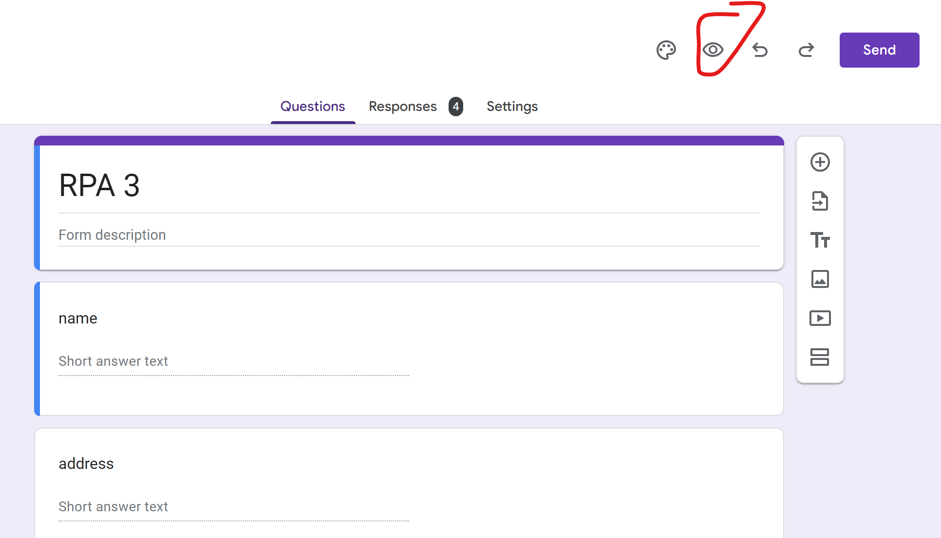
Register https://cloud.uipath.com/
Create google form https://docs.google.com/forms/
Create 2 question using short answer
Go to preview

Slide 20
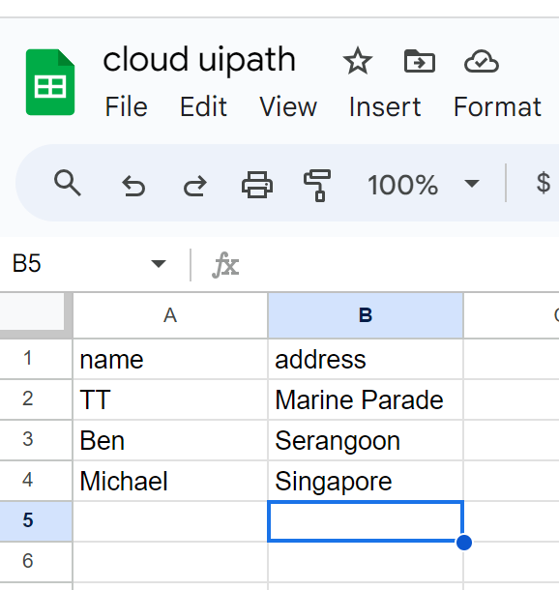
Create googlesheet - https://docs.google.com/spreadsheets (IT SHOULD BE SAVED IN GOOGLE DRIVE)

Slide 21
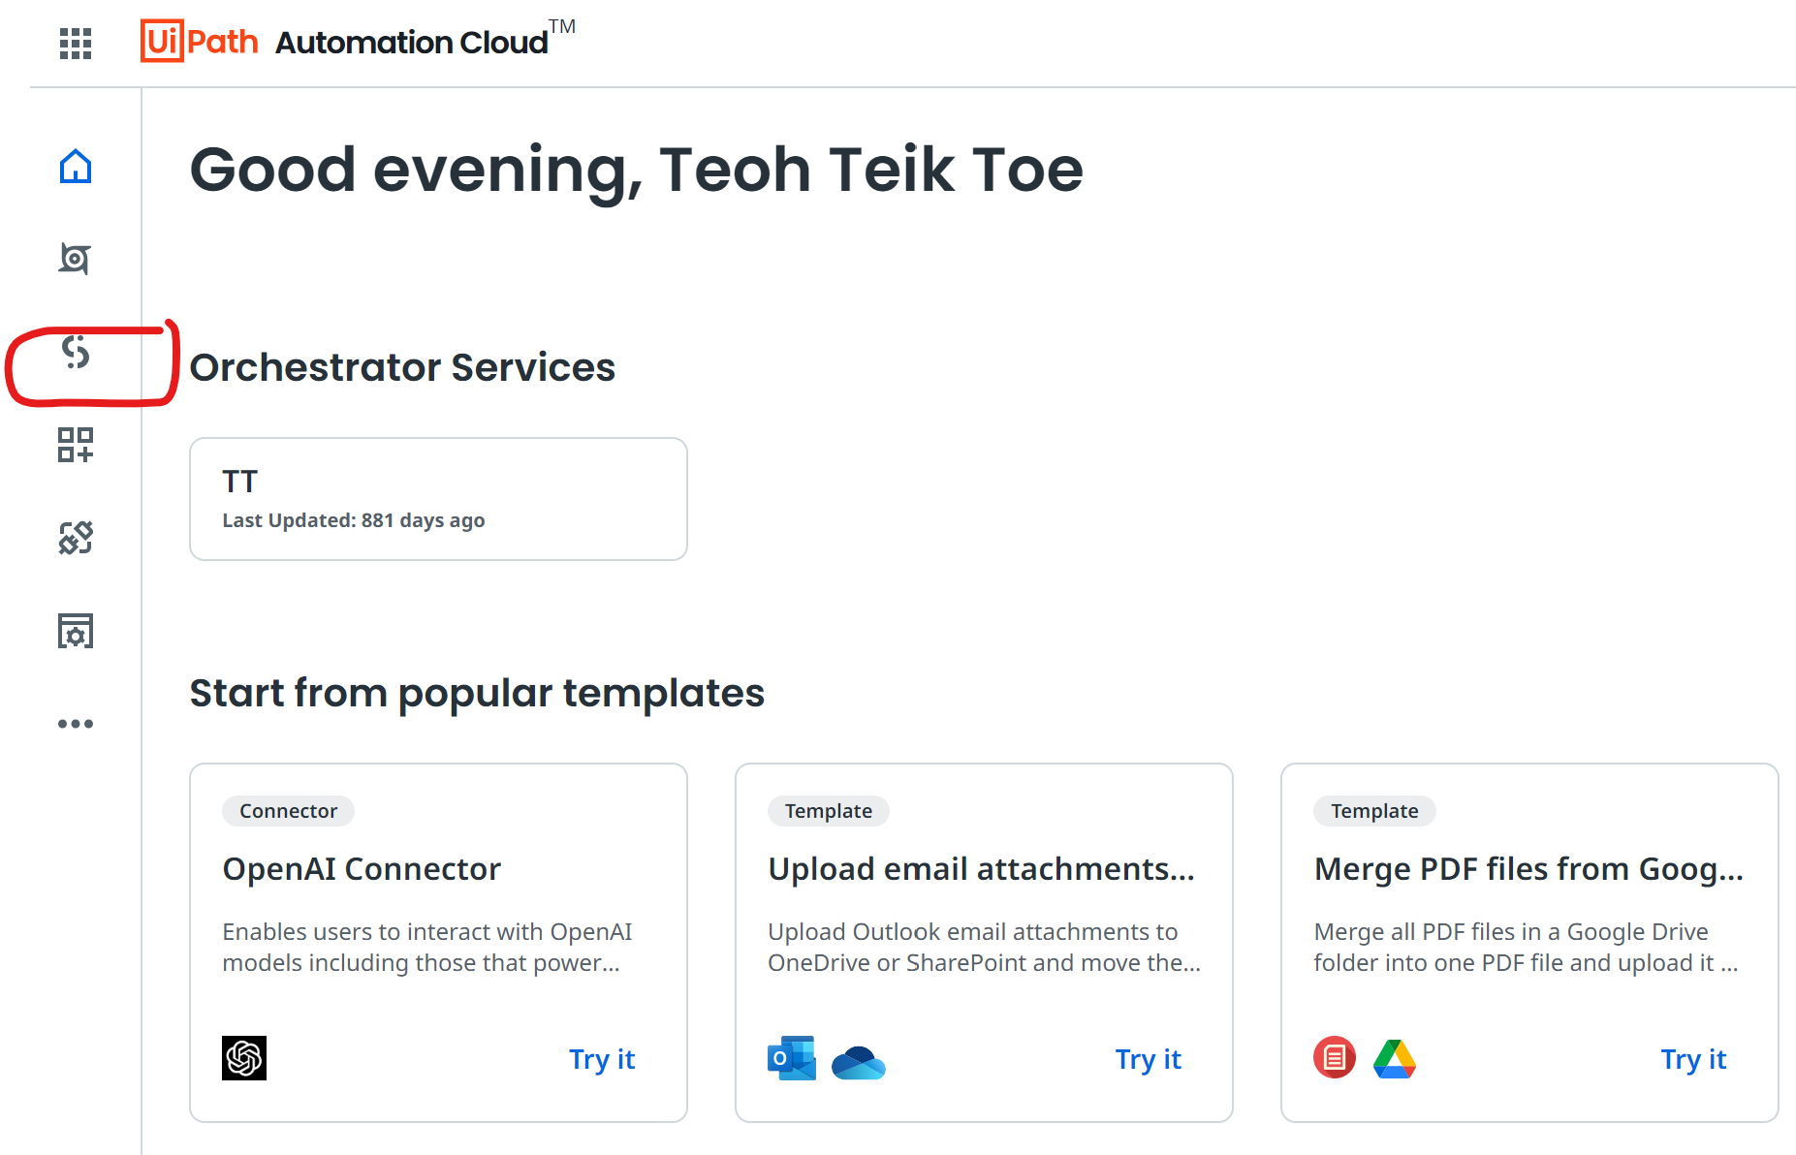
Register https://cloud.uipath.com/ select studio -> Project -> New Project

Slide 22
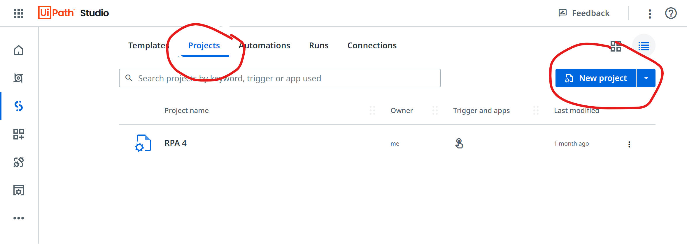

Slide 23
UiPath Steps
Use browser – select tab – ensure link end with viewform
Read range (google workspace) – select sheet (should be in your mydrive) – range select spreadsheet1 – click show addition – data should be in read range
For each – List of items (Read range.rows) – Use variable – read range – read range – row => Item in currentDataRow
Set Variable – use variable – for each – currentDataRow – name (repeat for all other features) – write lines
Type into – select tab – select entry and anchor – type this – use variable name
Click -> submit -> (then create a test form so that you can click submit another form) -> click -> submit another form
Check the result -> go to google form -> responses -> individual

Slide 24
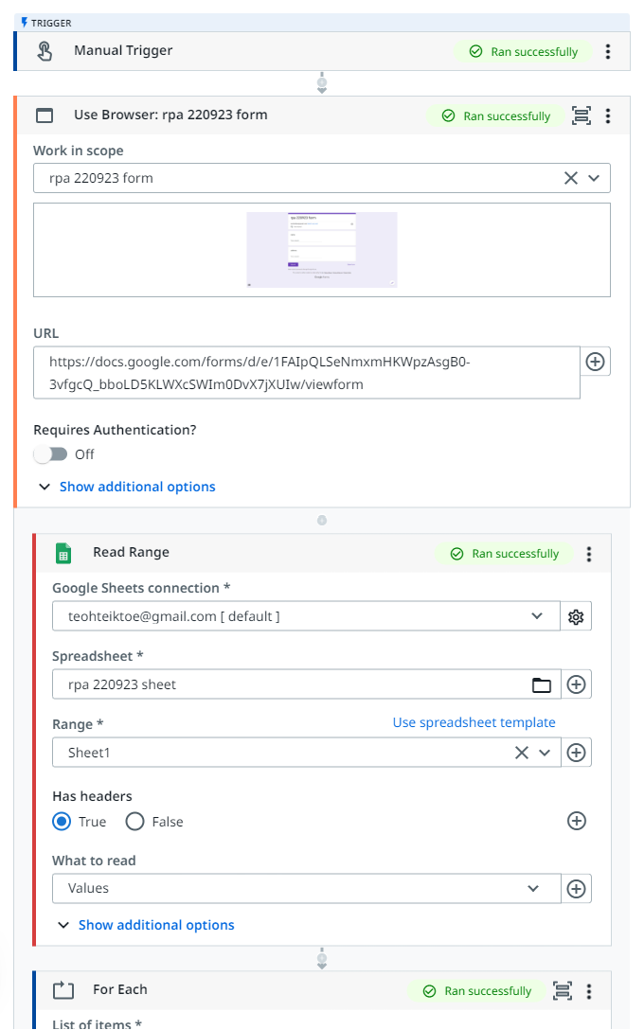
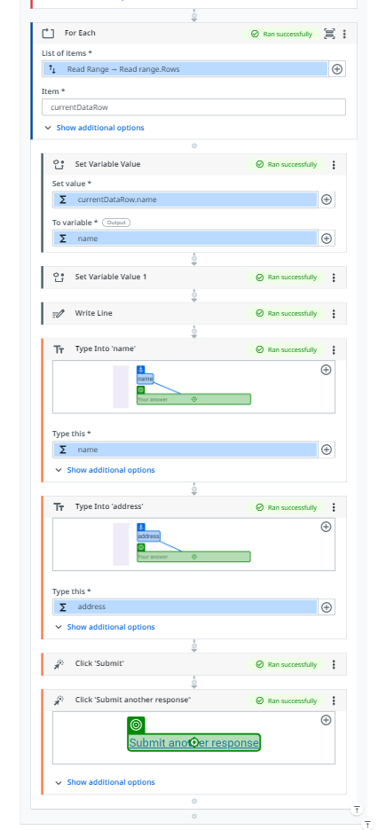

Slide 25
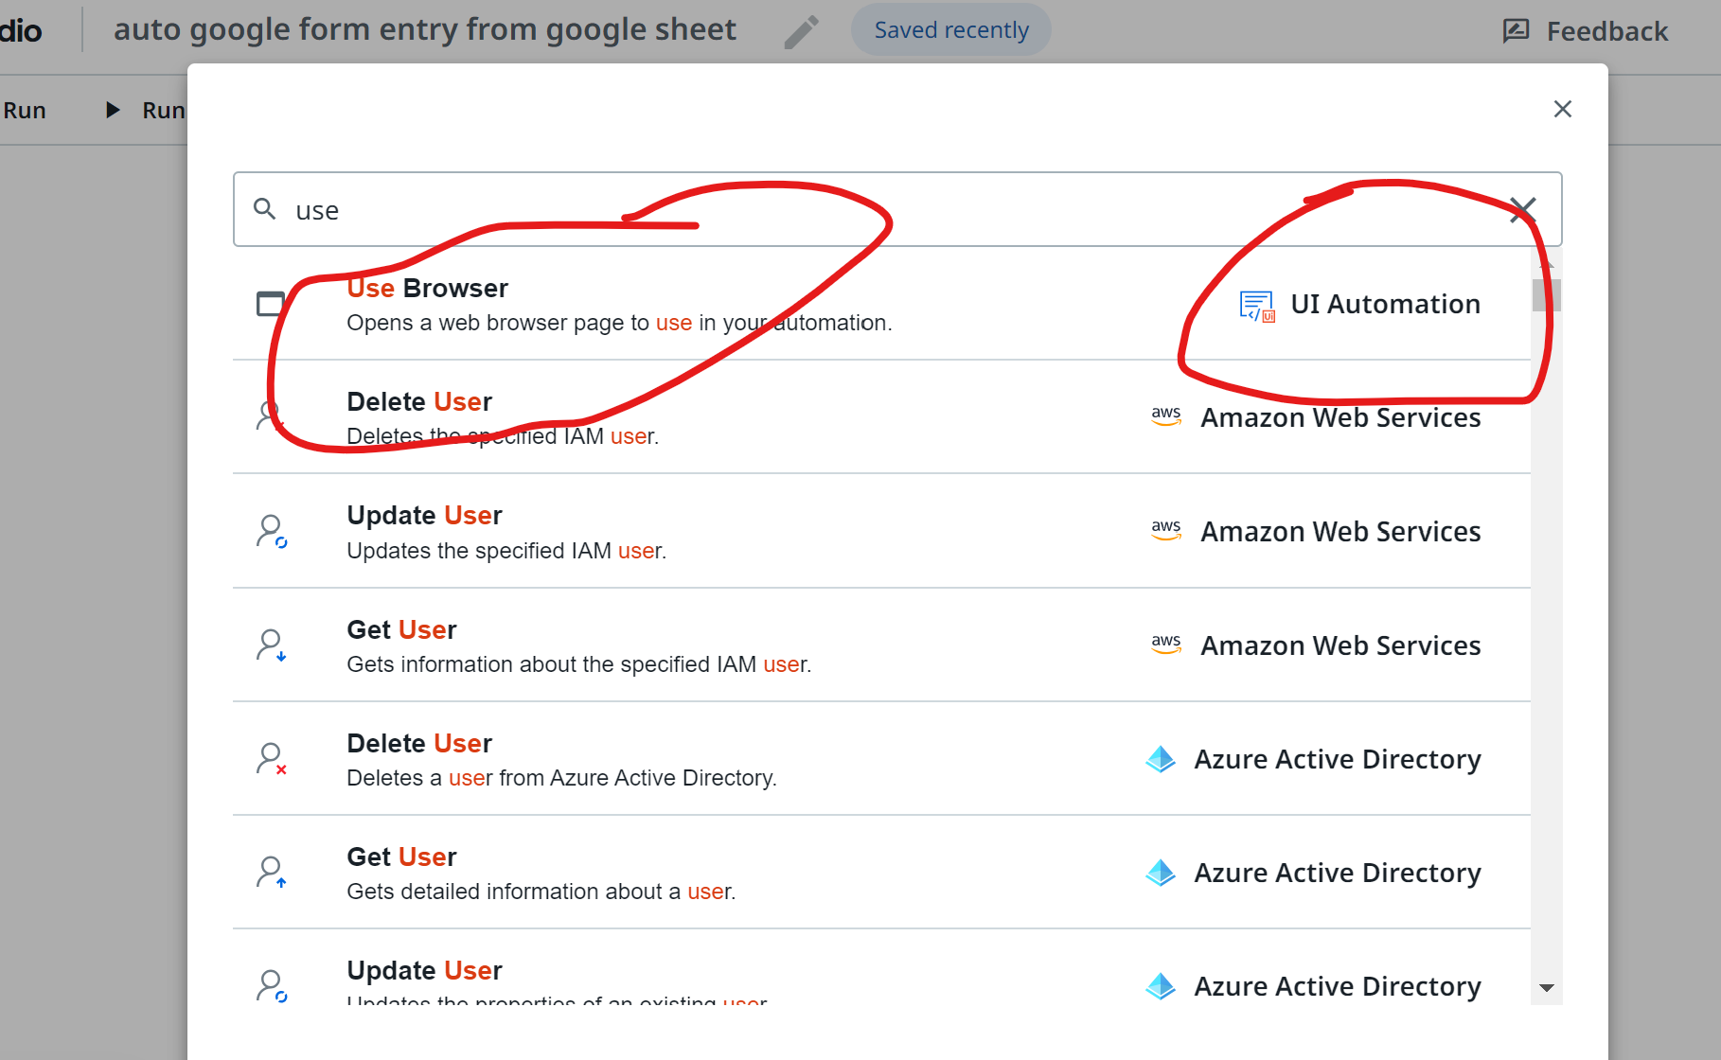
(1) Use browser

Slide 26
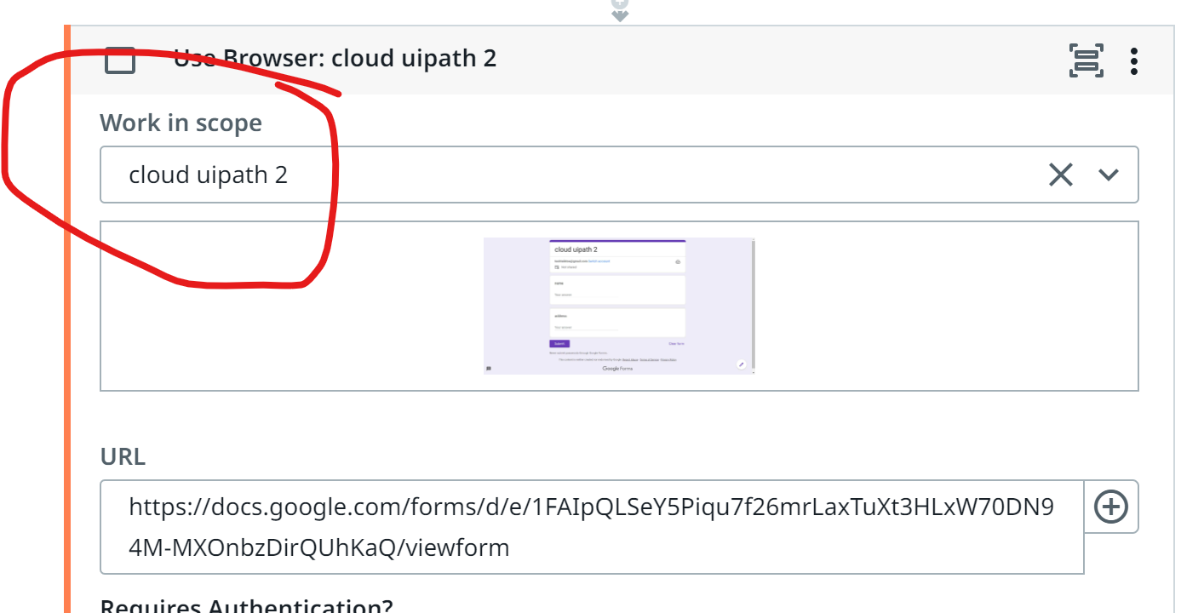
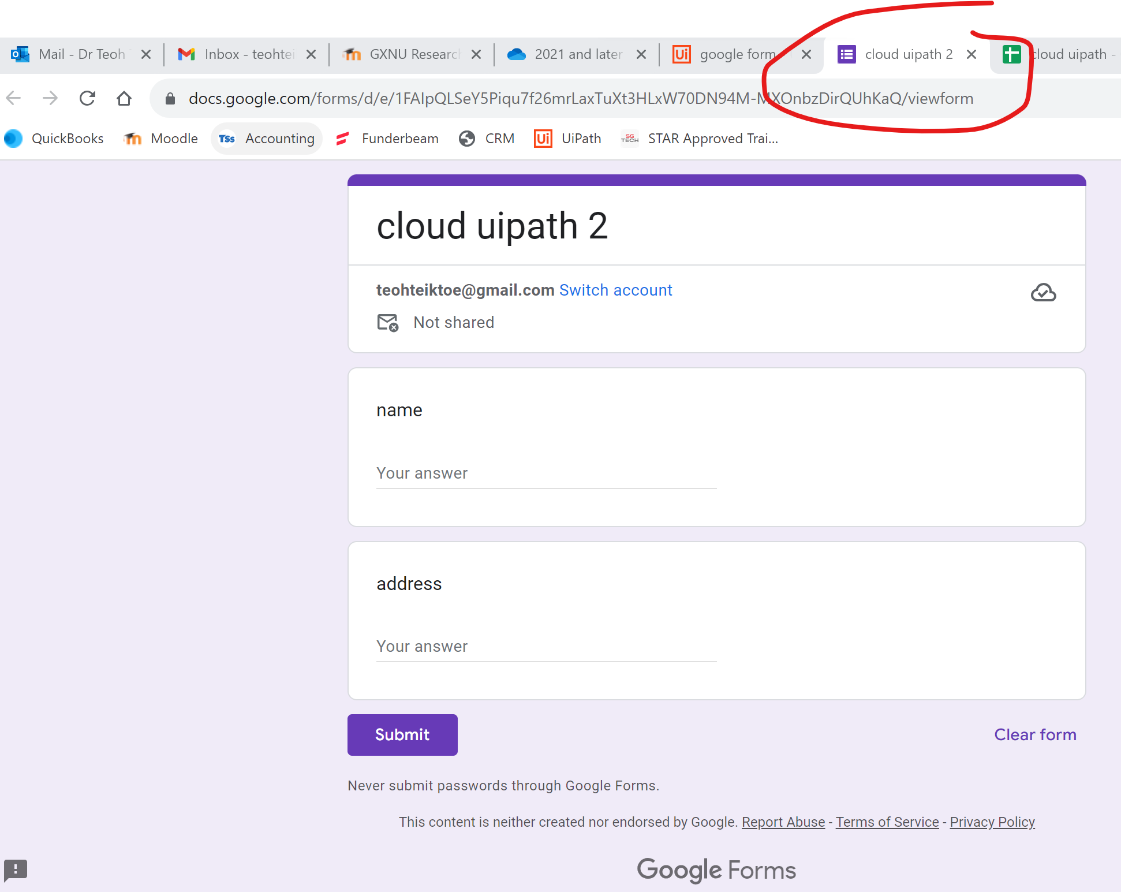
In Work in Scope -> Select tab -> make sure the link end with viewform

Slide 27
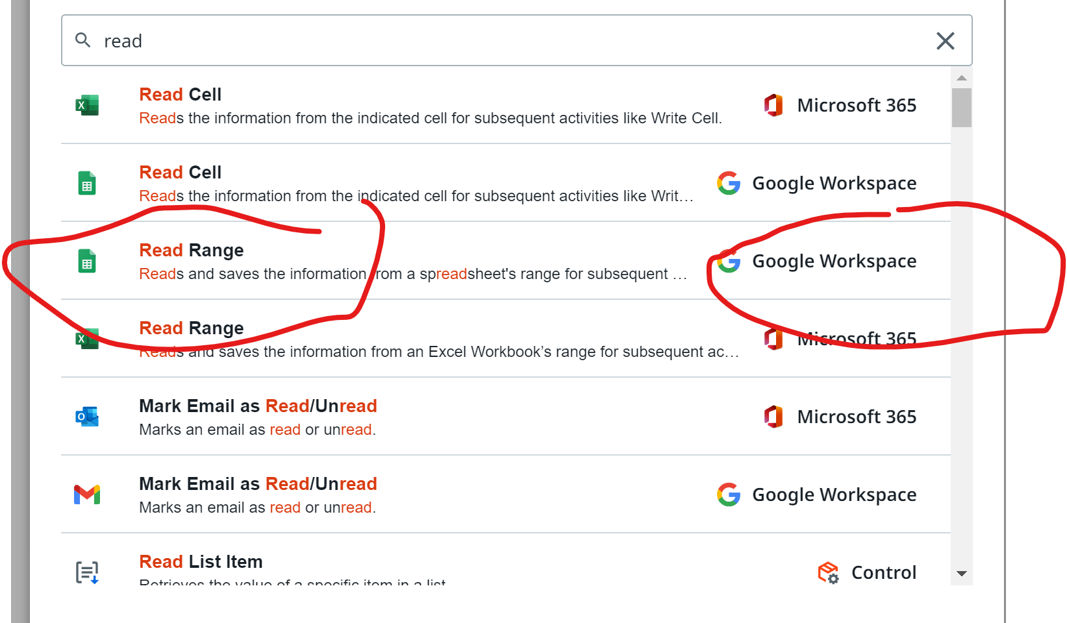
click on + -> (2) Read range – google workspace

Slide 28
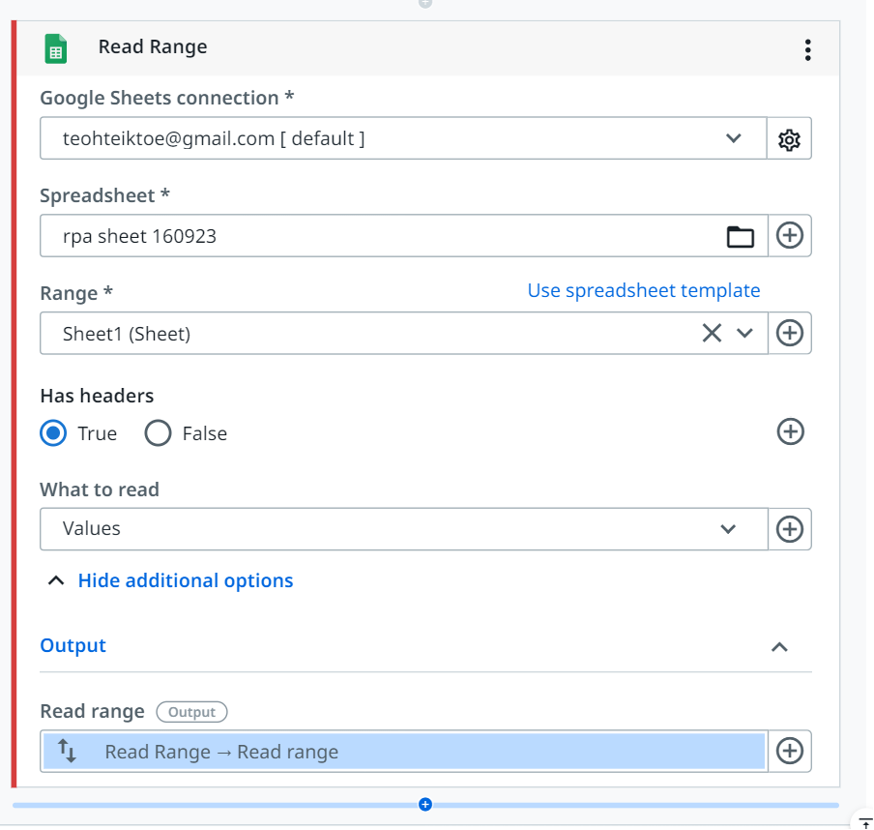

Slide 29
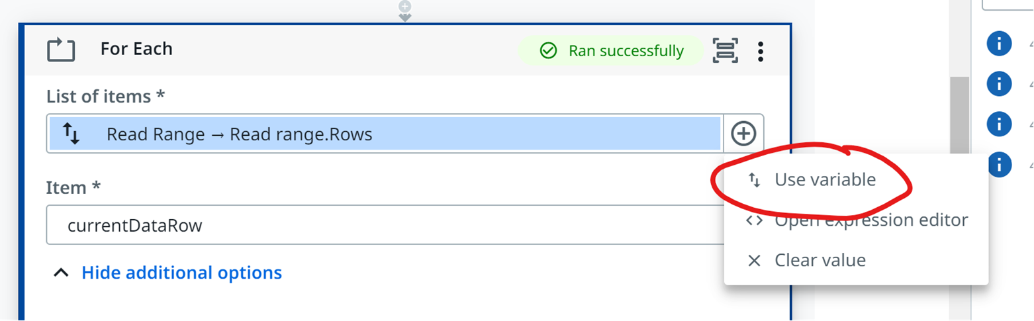
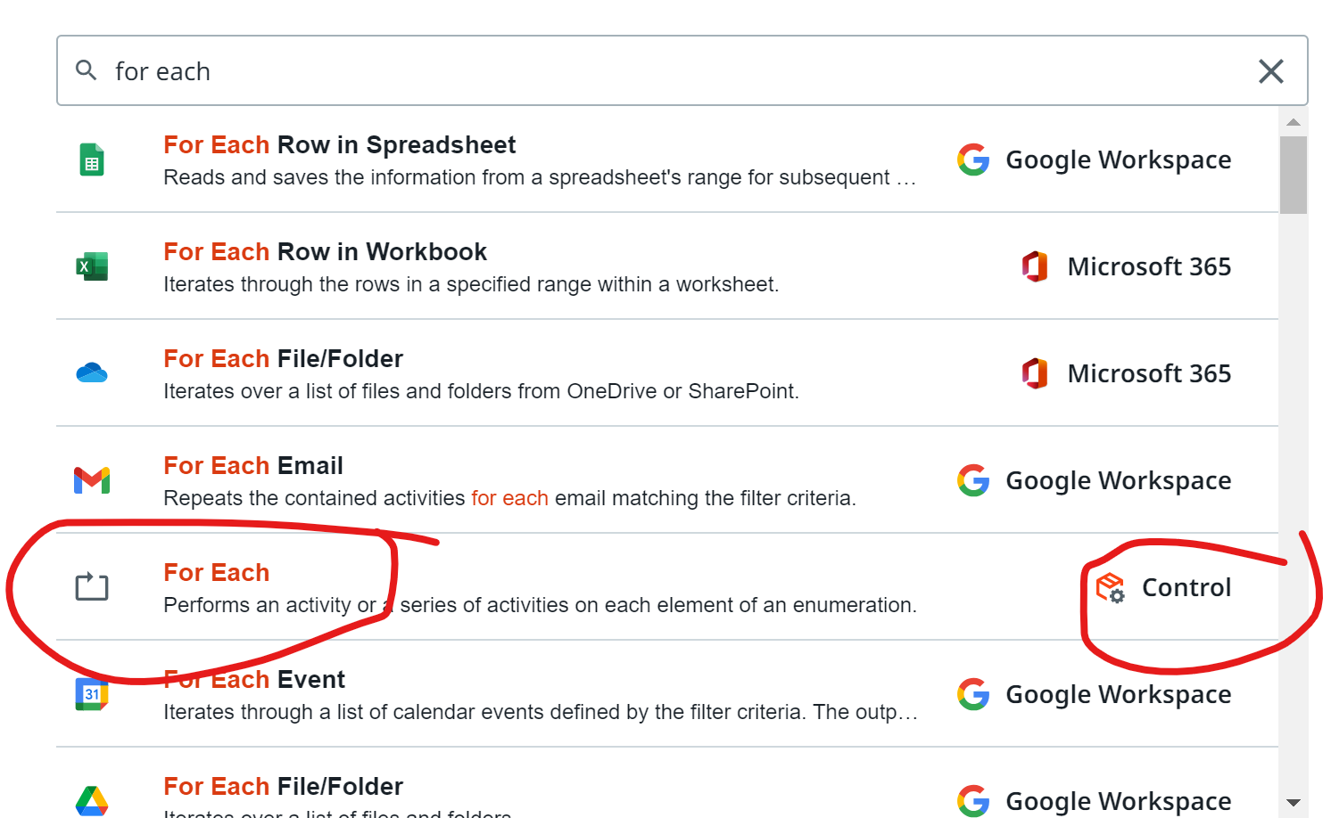
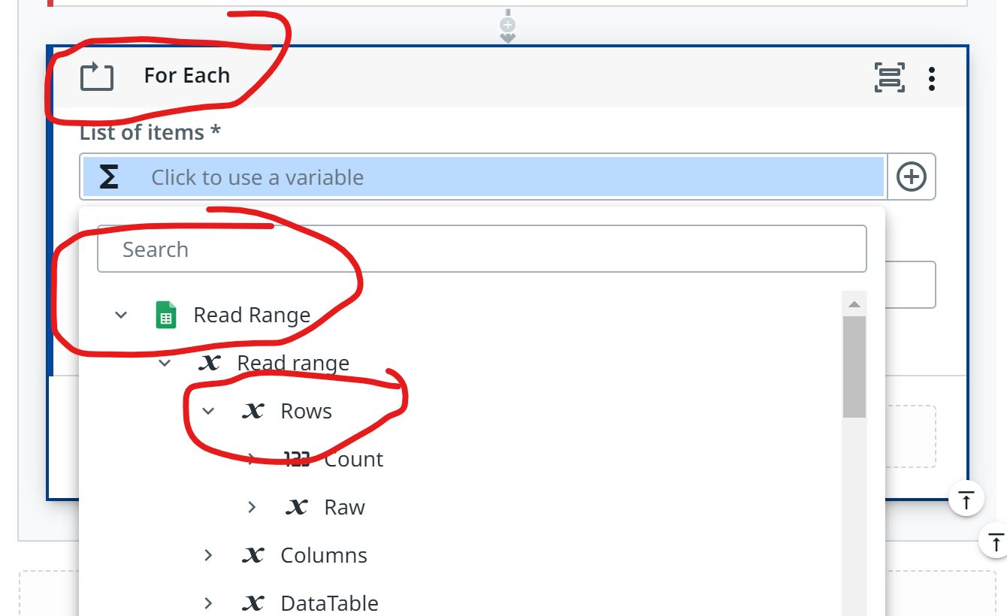
3. For each

Slide 30
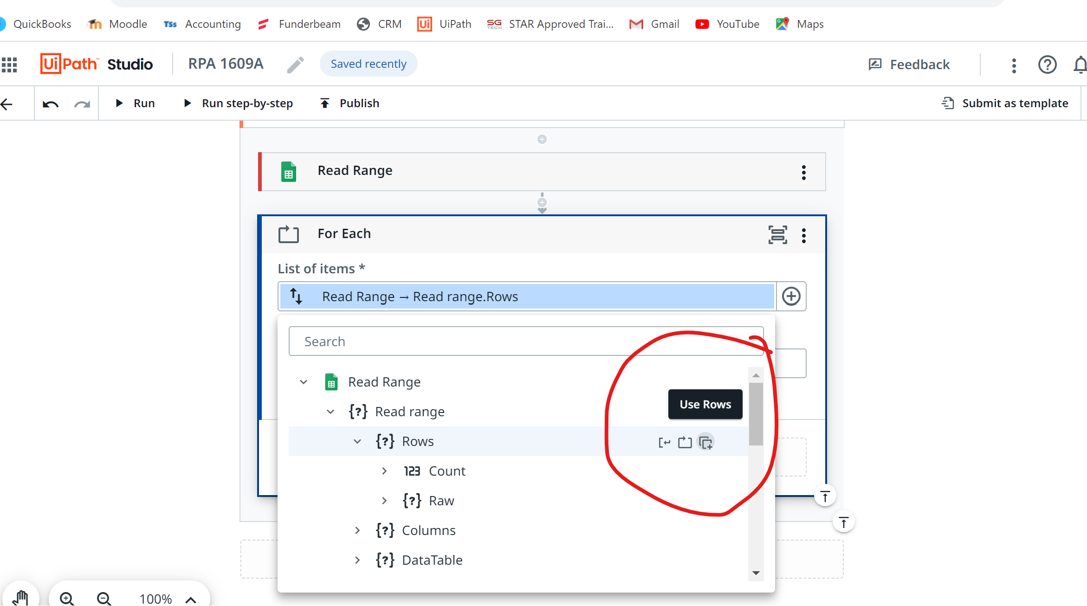
List of items -> read range -> Use rows

Slide 31
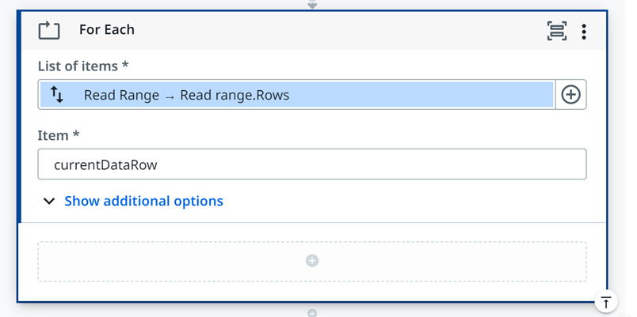

Slide 32
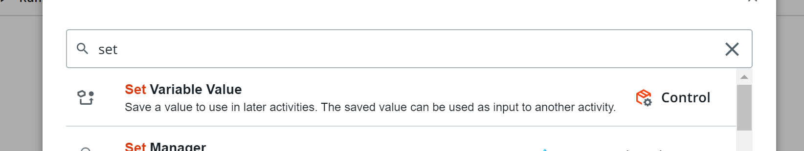
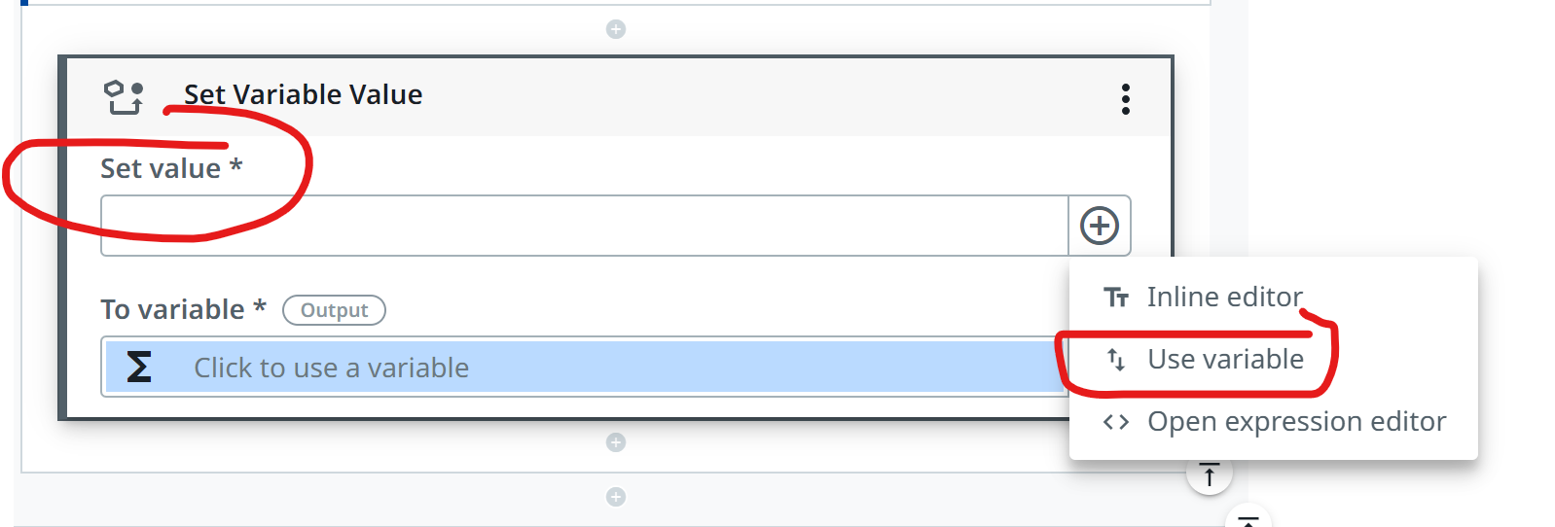
4. Set variable value Set Value – use variable -> for each -> currentDataRow -> Name To variable -> create new variable

Slide 33
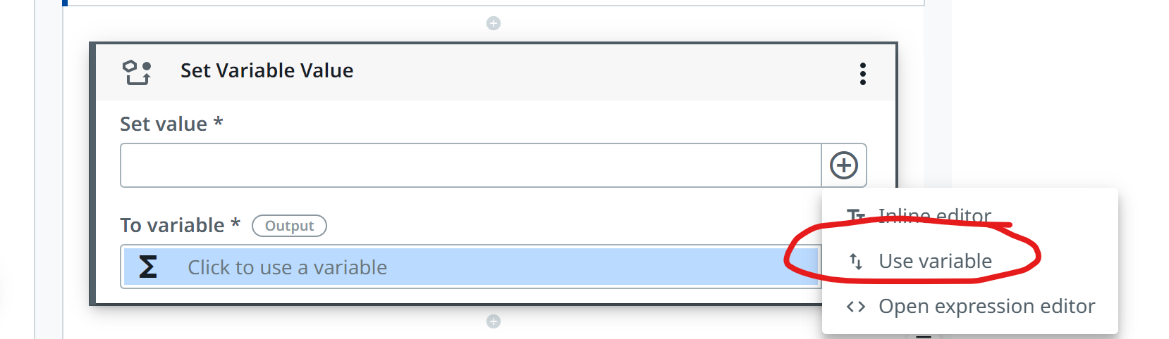
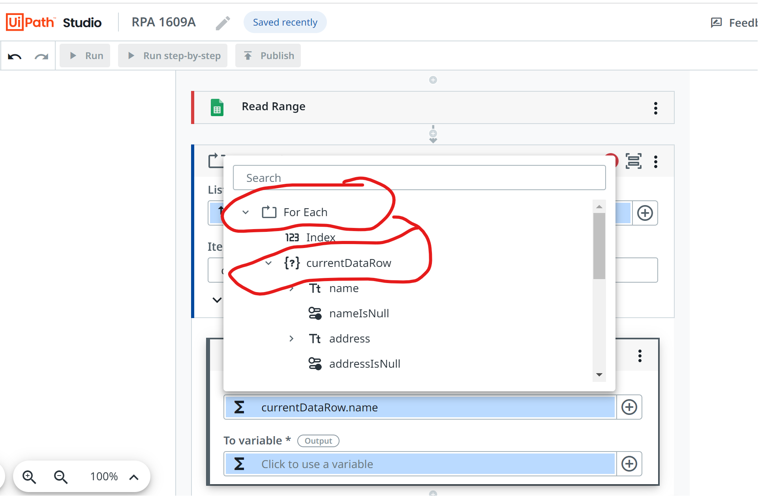

Slide 34
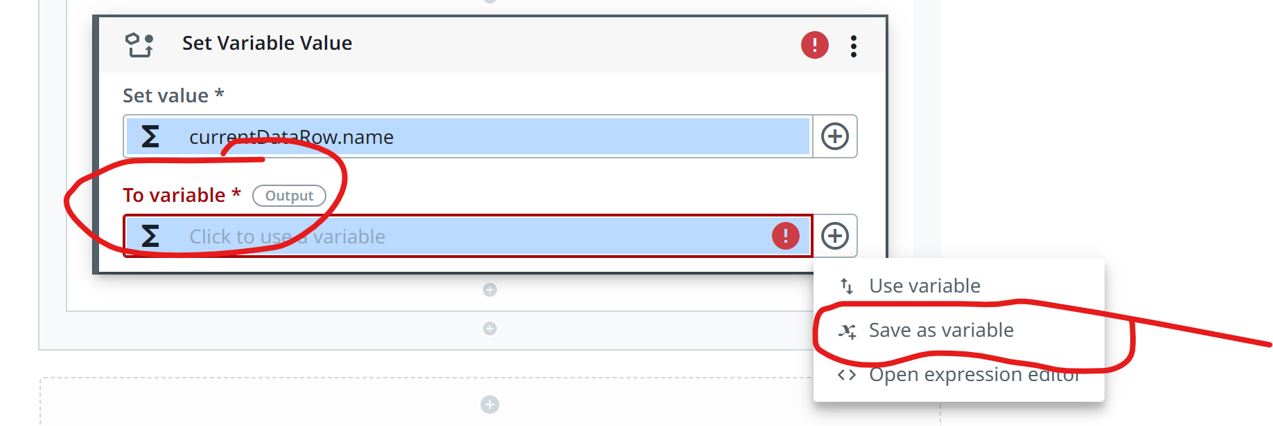
Save as variable

Slide 35
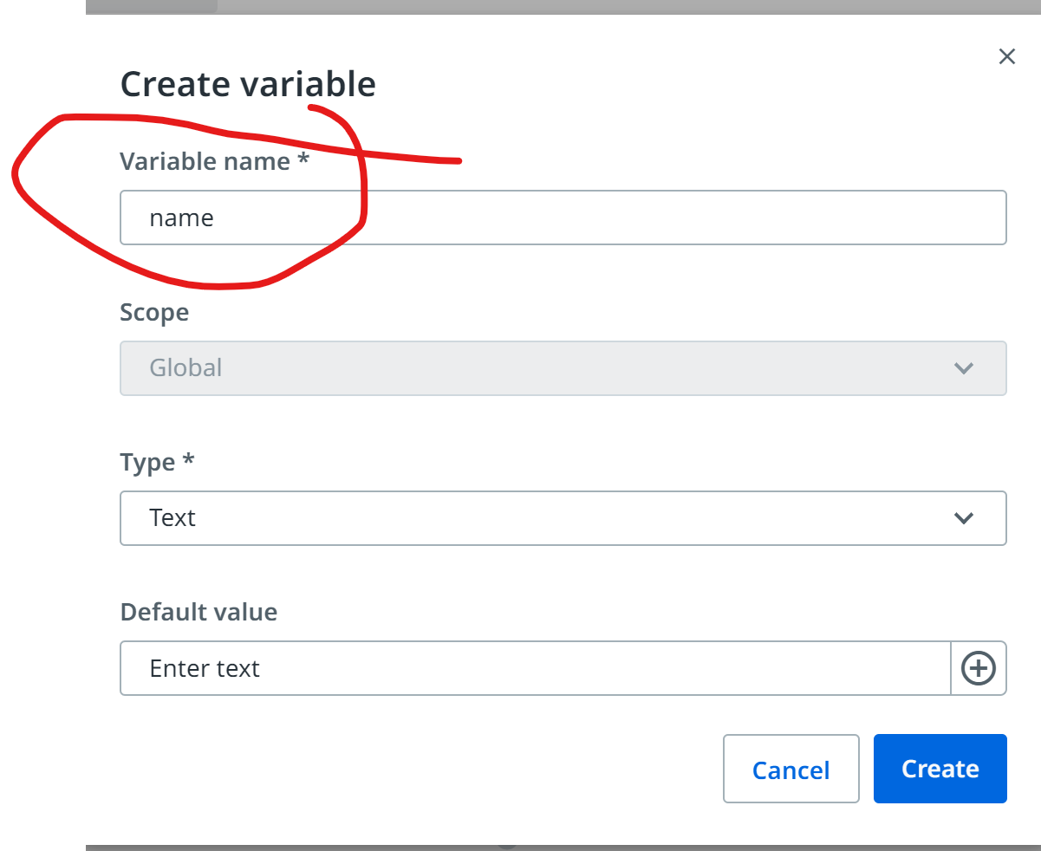

Slide 36
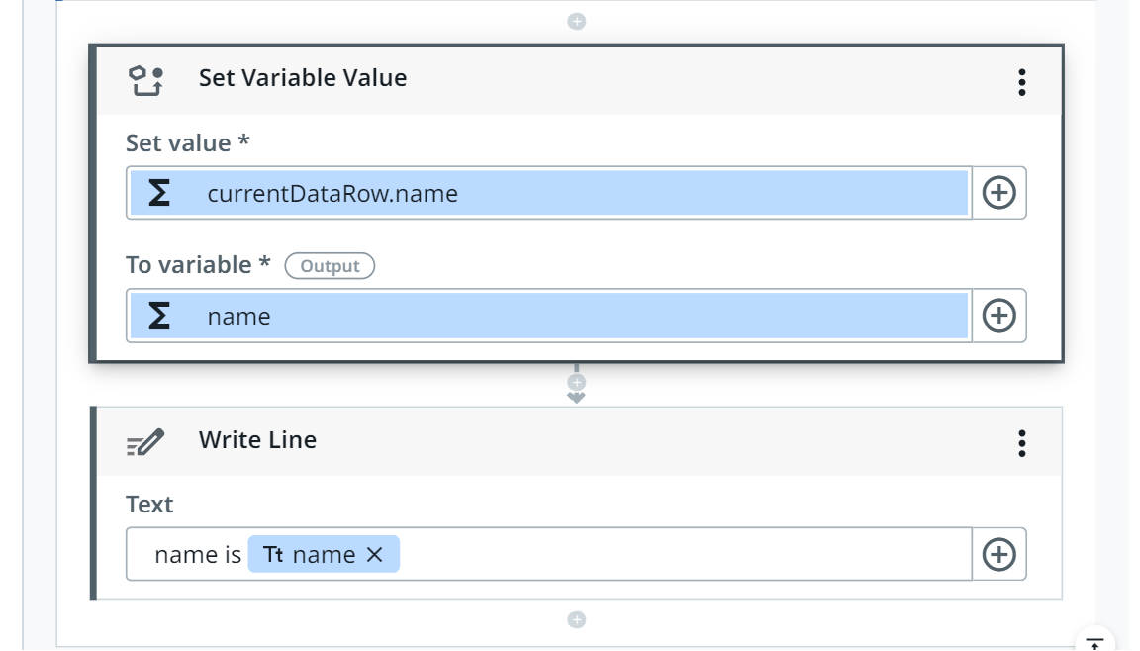
Write line

Slide 37
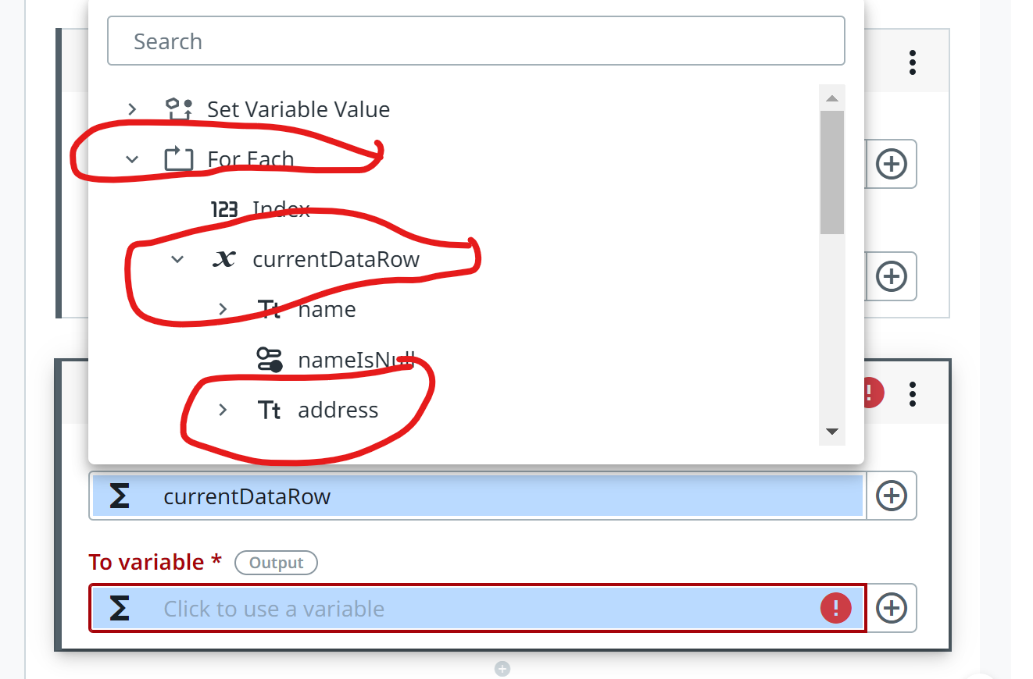
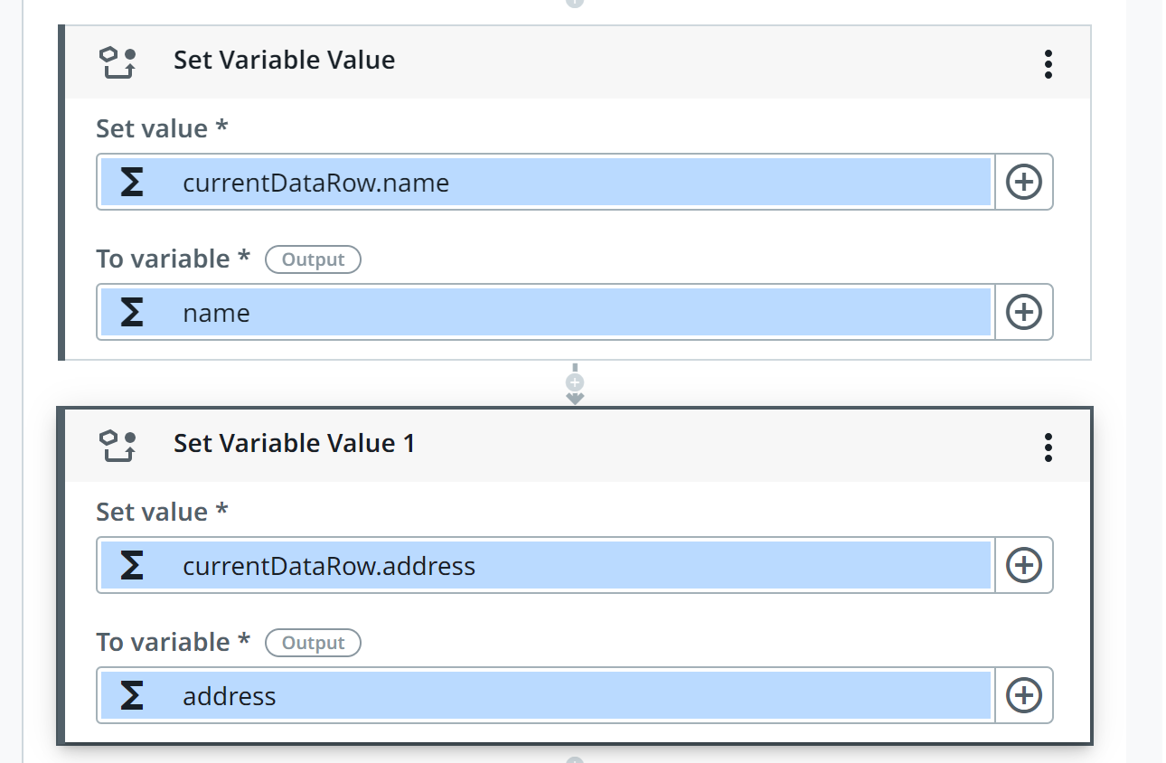
DO the same for address

Slide 38
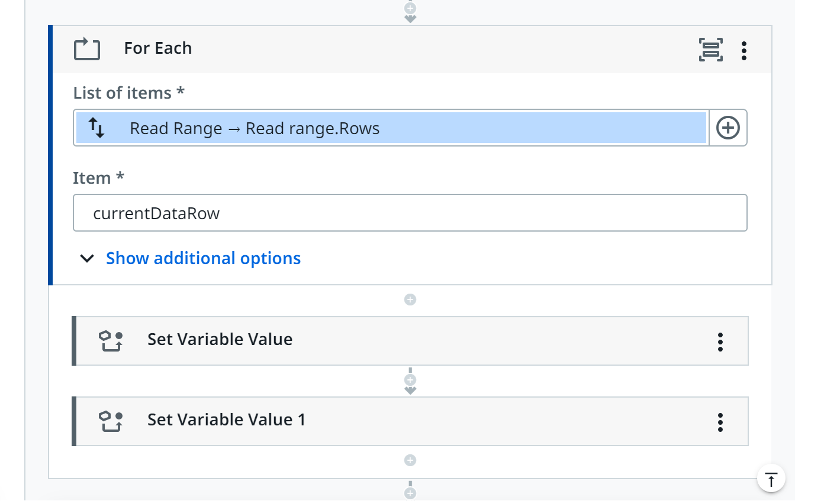
2xSet variable (name and address) in with for each

Slide 39
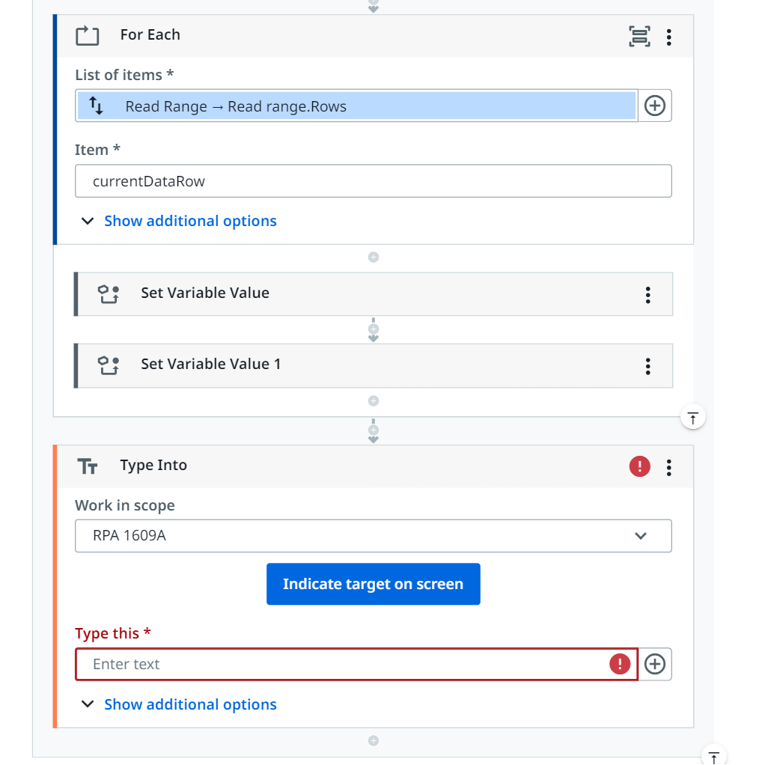
Step 5 type into MUST BE INSIDE of for each

Slide 40
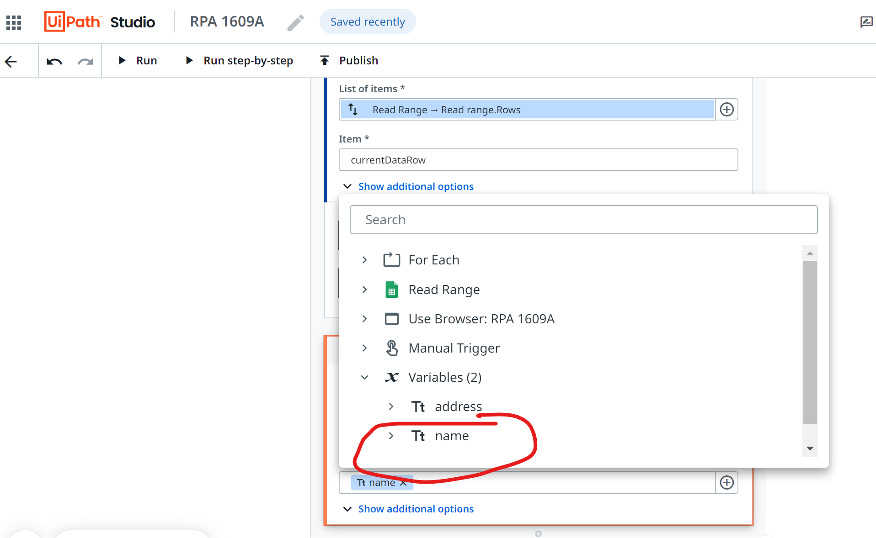
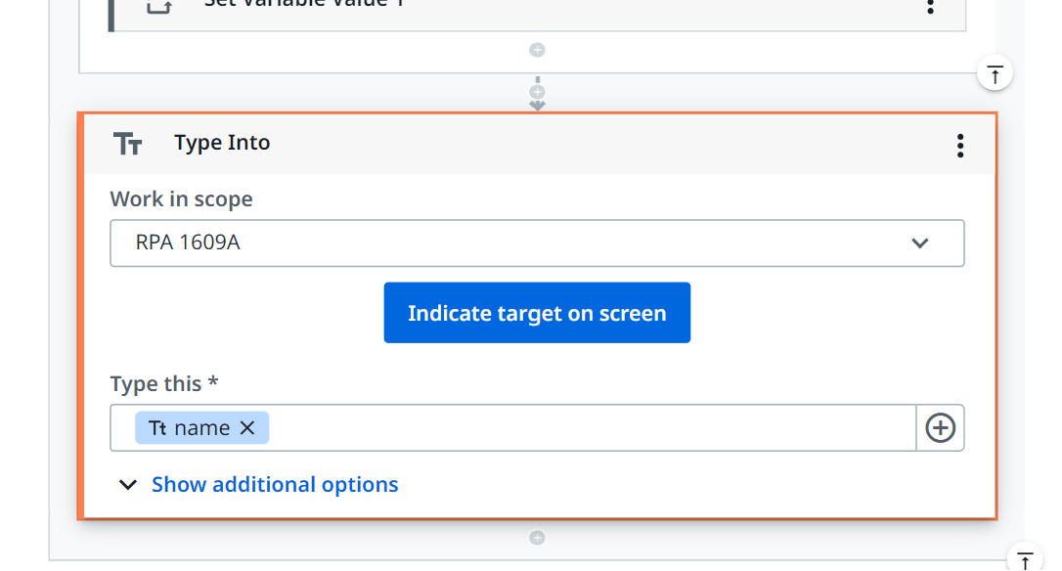
Step 5: in type this – select name as variable

Slide 41
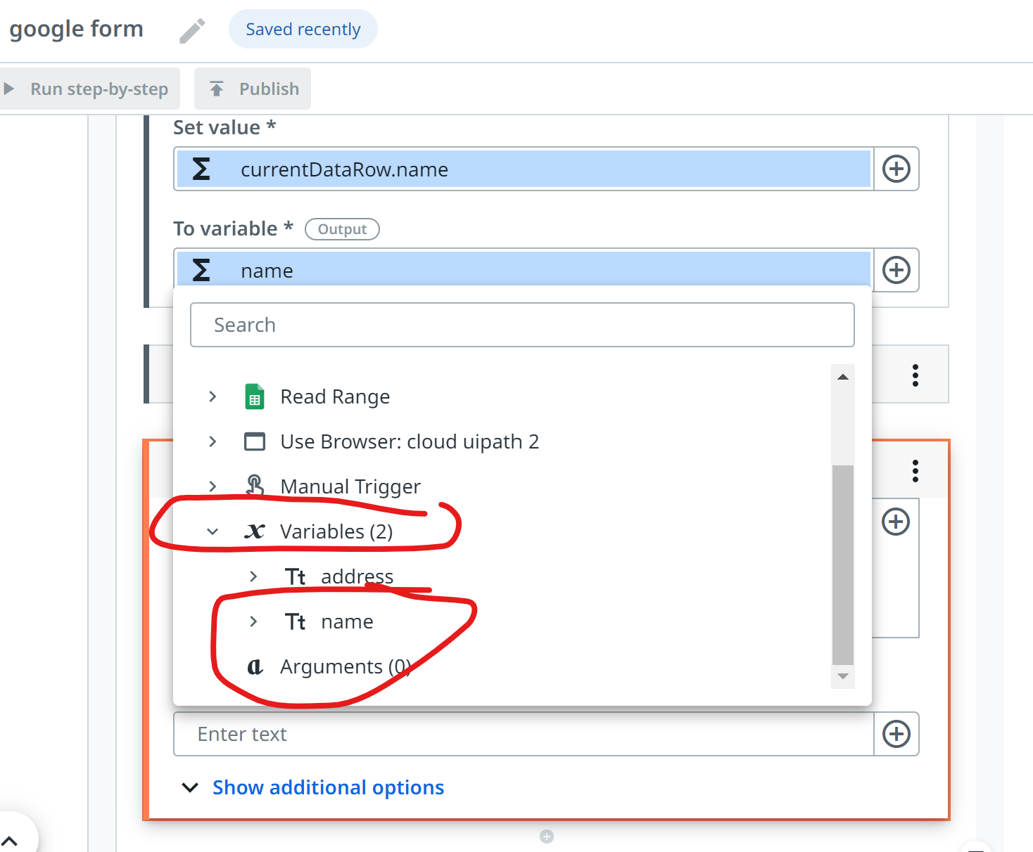

Slide 42
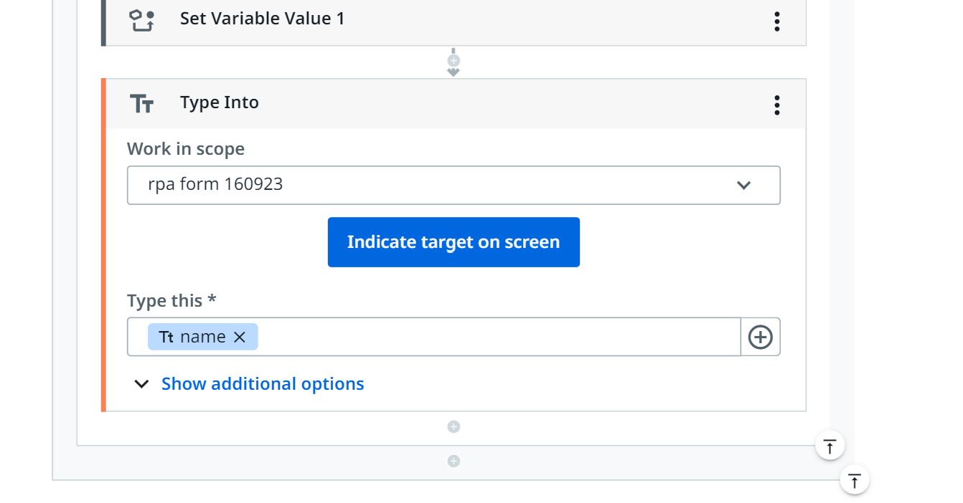
In indicate target on screen

Slide 43
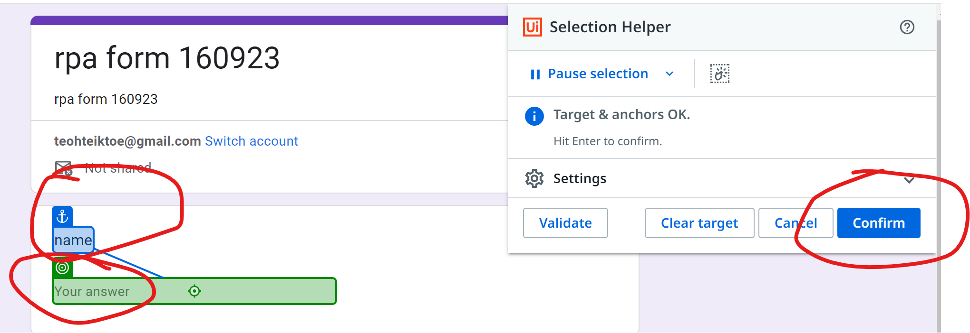
First, second (anchor) then Select confirm

Slide 44
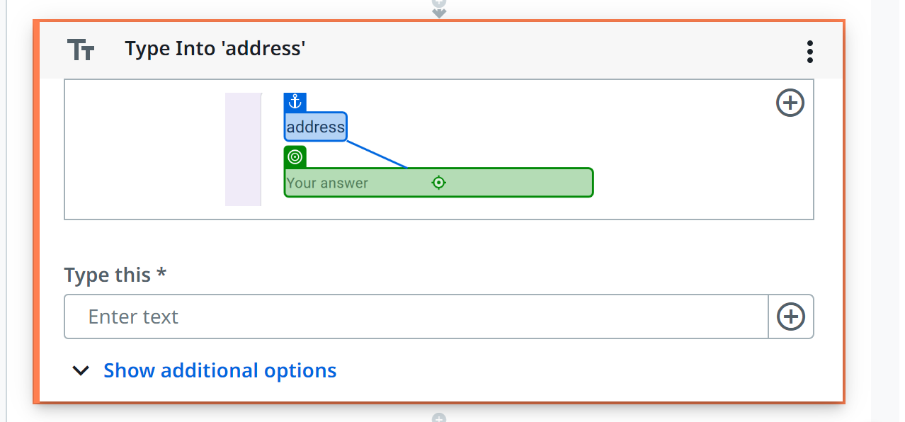
Do the same for address

Slide 45
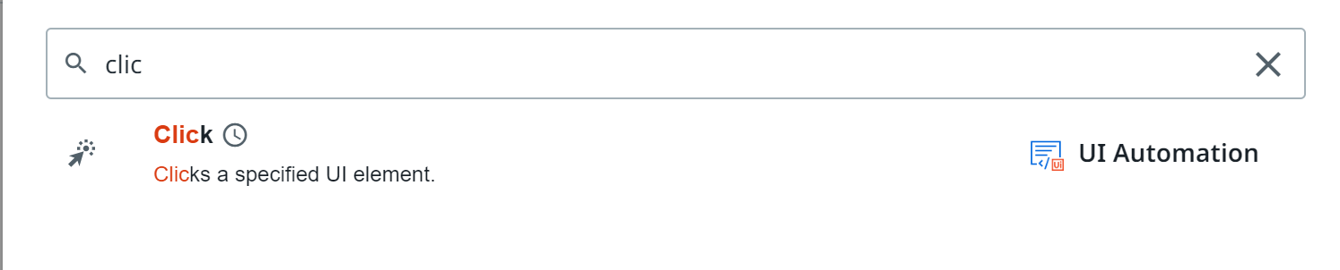
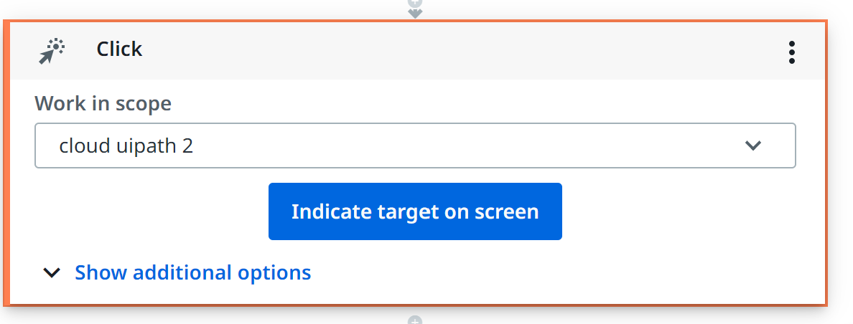
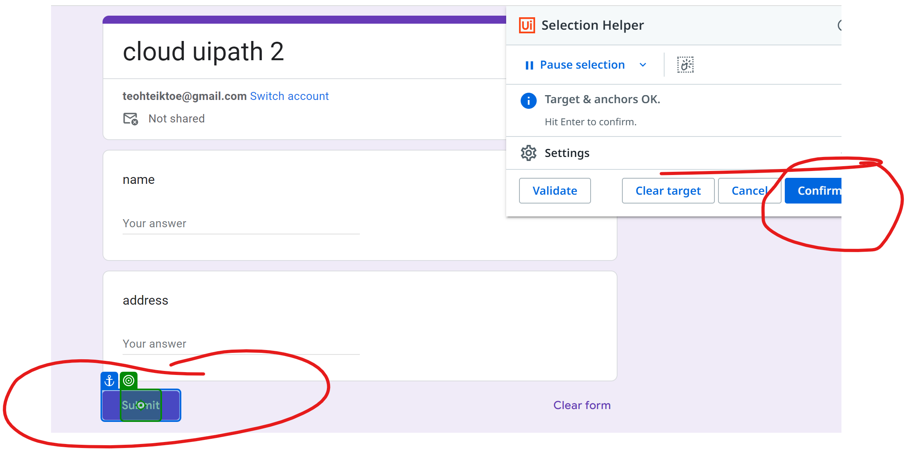
Click - submit

Slide 46
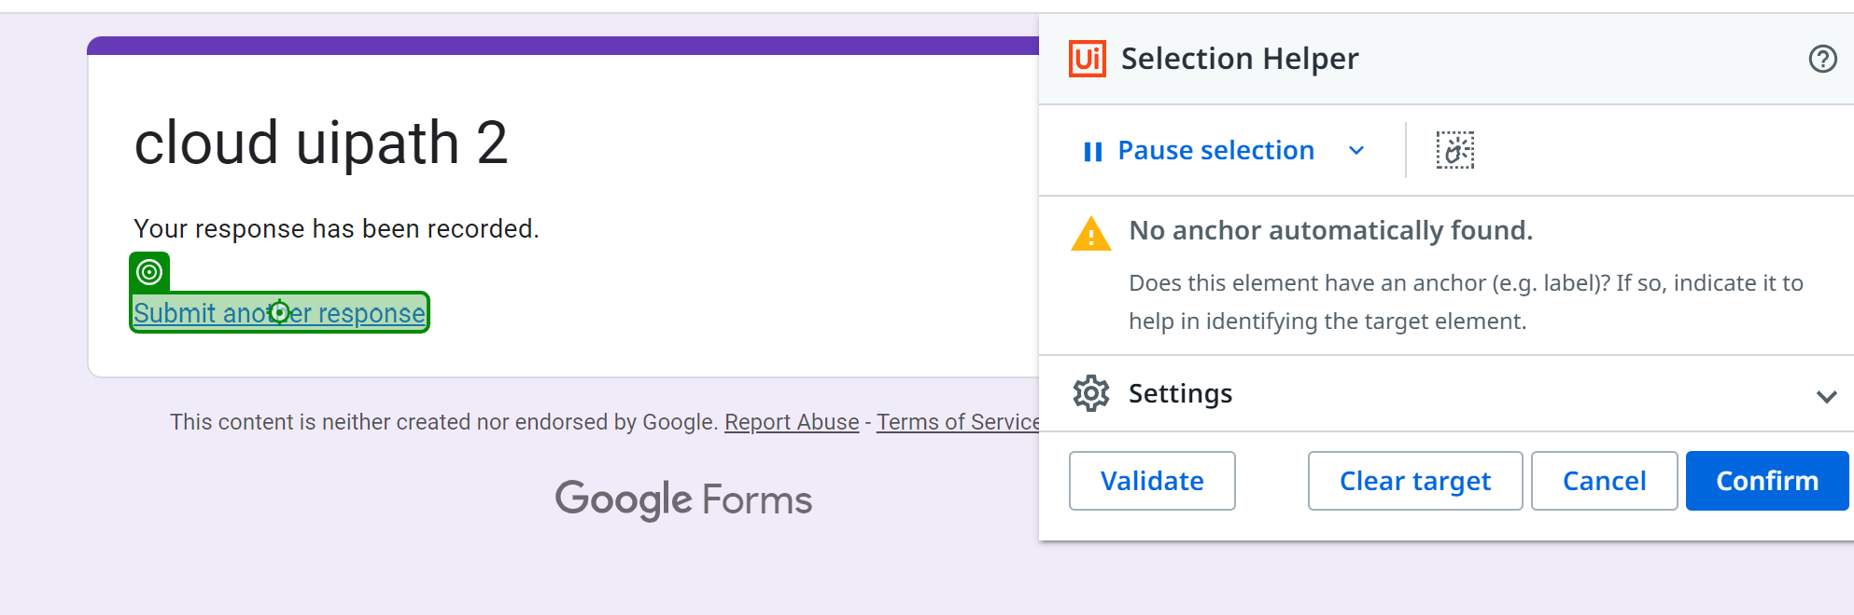
Click – submit another form – BEFORE YOU DO THIS, YOU NEED TO ENTER DUMMY DATA in form TO REACH HERE

Slide 47
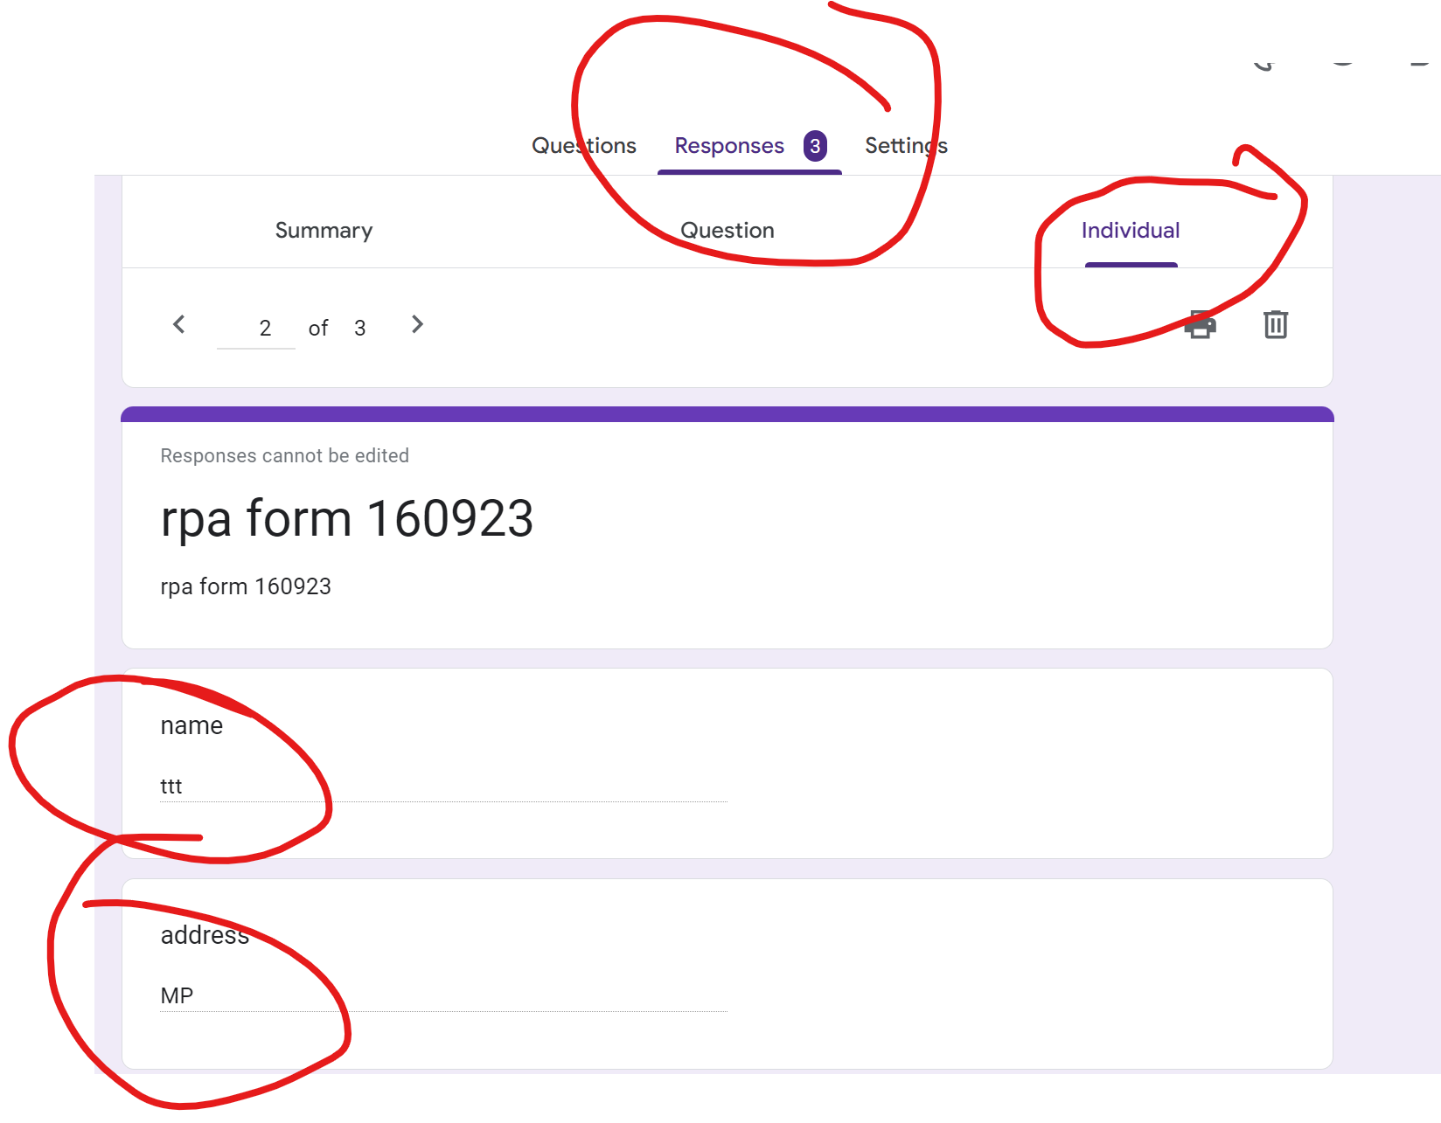
Run and Check the result

Slide 48
Exercise
Create a google form to accept : Name, Email, Hobbies, Education
For google sheet: Either download csv or cut and paste into google form
Automate the process of entering the 5 data from google sheet to google form using uipath cloud
Name | Email | Hobbies | Education
William Grayson | wgrayson94@fakemail.com | Mountain biking, photography, board games, reading sci-fi novels | B.A. in Communications
Mariah Vazquez | mariah.v88@fakemail.com | Gardening, yoga, and baking | BSN
Samuel Lipton | s.lipton75@fakemail.com | Chess, astronomy, and playing the saxophone | M.Ed. in Secondary Education
Ayesha Patel | ayesha.p99@fakemail.com | Painting, blogging, and hiking | B.Tech in Computer Science
Clara Gonzales | clara.g81@fakemail.com | Scuba diving, wildlife photography, and bird watching | Ph.D. in Marine Biology

